Slide 1
Unit Testing
Android studio

Slide 2
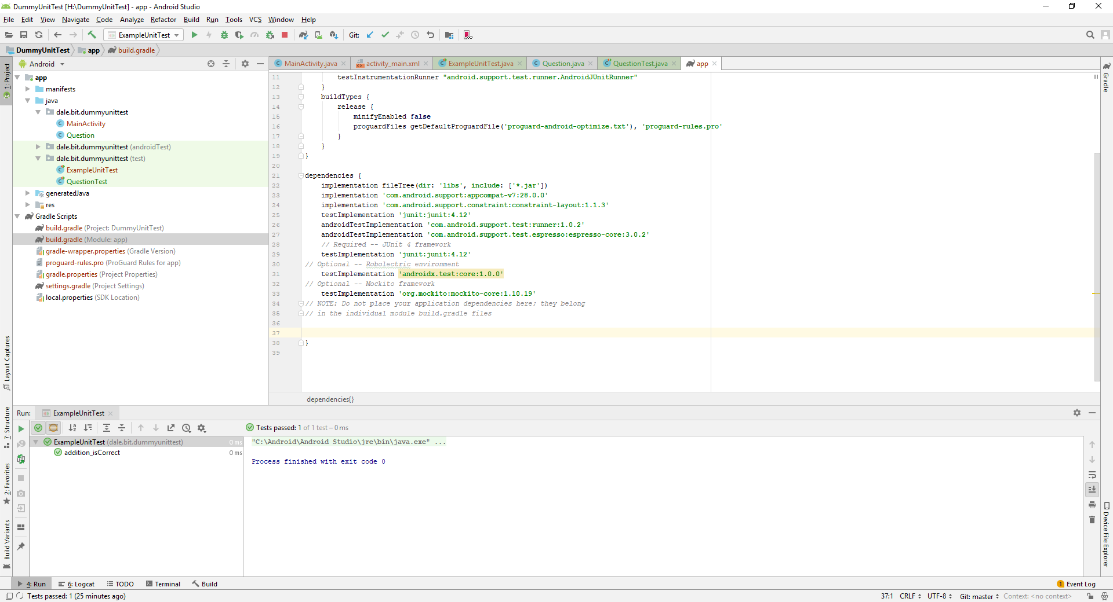
Add dependencies

Slide 3
Paste into build.gradle (Module:app)
// Required -- JUnit 4 framework testImplementation 'junit:junit:4.12' // Optional -- Robolectric environment testImplementation 'androidx.test:core:1.0.0' // Optional -- Mockito framework testImplementation 'org.mockito:mockito-core:1.10.19' // NOTE: your application dependencies belong // in the individual module build.gradle files

Slide 4
After pasting the dependencies
Remember to rebuild the project
Project|rebuild

Slide 5
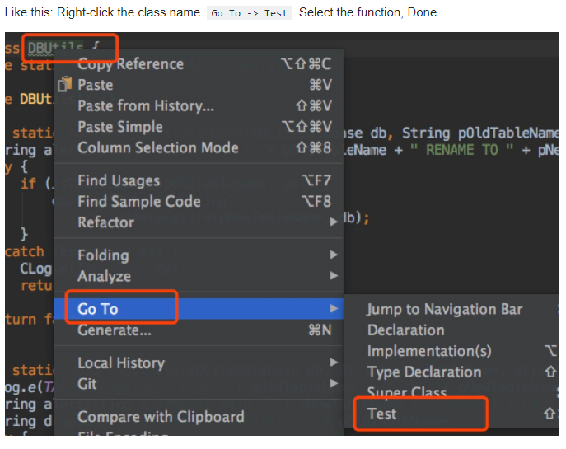
In the class you want to test, on the class name or any method name- right click

Slide 6
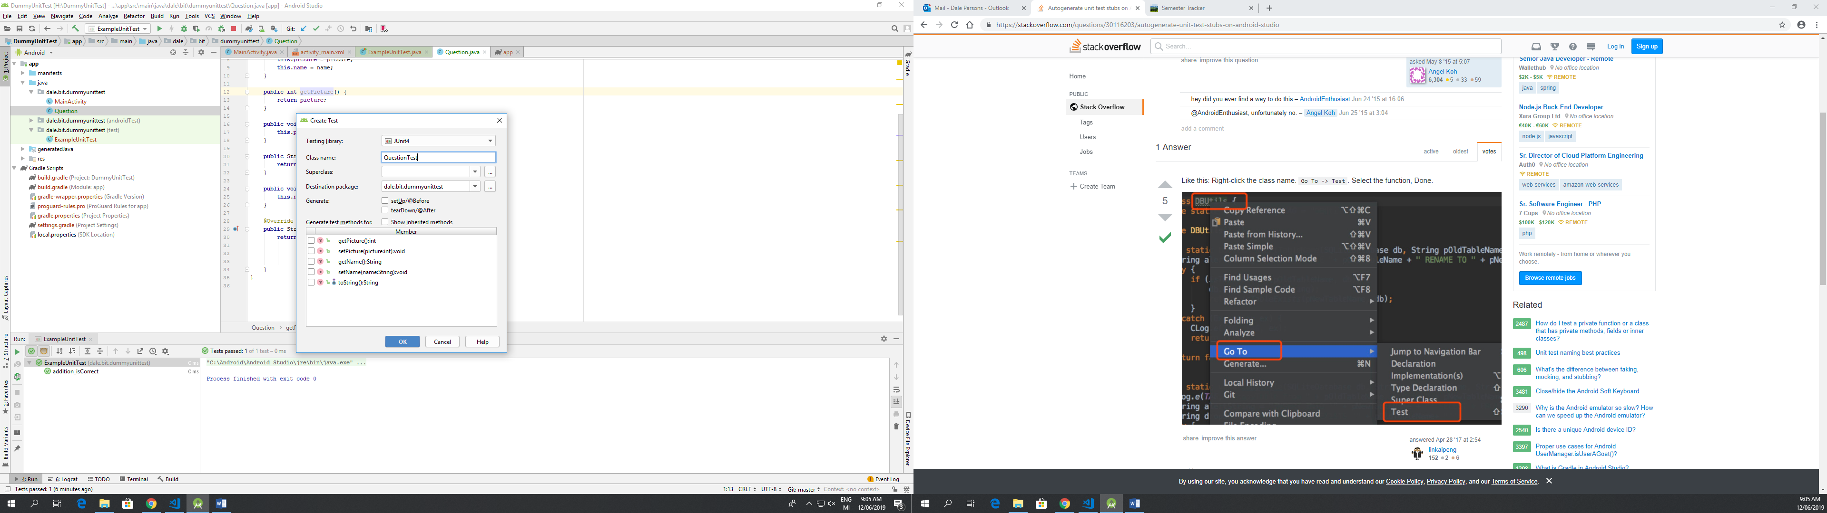

Slide 7
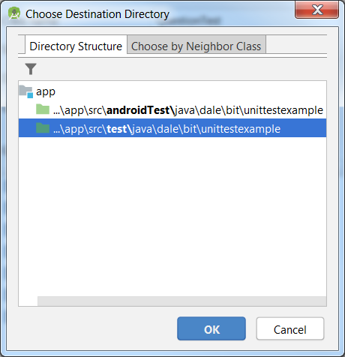
Choose the second option

Slide 8
Tidy up
Rename each test method with the word Test at the end
Eg toStringTest()
Write your tests
Right click and run the Test Class

